Slide 1
EasyCharge
Electric vehicle charging assistant

Slide 2
Problem
EV charging is too slow
Makes the technology harder to adopt
Home charging isn’t always enough
EV Charging Stations
Disturbs user’s time schedule
May have to wait in long queues
Google Maps not enough

Slide 3
Needs
Consider factors relevant for EV charging
Fast vs. Slow
Queue management
Point to point connectivity
On the way to destination
Enough to reach home
Enough to reach work

Slide 4
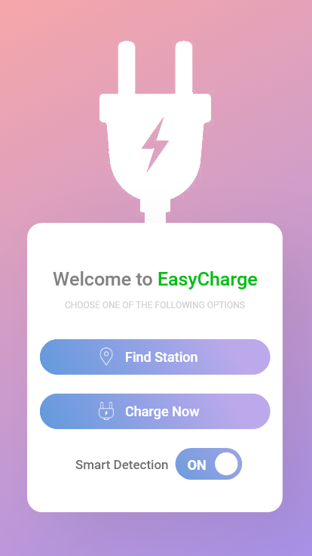
Solution - Assistant
Where to charge
Not just the nearest, unlike Google Maps
Queue Management system
When to charge (PRO ONLY)
Smart detection (Real time data)
Battery-based
Route-based
How much to charge
To prevent over-crowding and saving money

Slide 5

Outcome
Consumer satisfaction
People likely to adopt EV
Increase in user base
Smart allocation of resources for increased users
Increased revenue

Slide 6
Demo
Alt-tab

Slide 7
Anonymous Data Collection
Assistant app will generate data that couldn’t have been collected.
Queue sizes at varying times
Notification to admin if re-allocation needed
Diagnostic data specific to car make and model
Notification to driver if car doesn’t follow pattern
Make Model | Time | Percent
Mahindra E2O | 20 | 18
Mahindra E2O | 20 | 18
Mahindra E2O | 20 | 6
Mahindra E2O | 20 | 18
Mahindra E2O | 20 | 6

Slide 8

Financial Model
Capital, Investment, Expenditure
Power Tariff
Land Rent
Infrastructure Improvement
Research and Development
Server Cost
Revenue Generation
EV Charging Tariff
Premium App Services
Priority Services

